Slide 1
Credit Card Fraud Prediction
by
Pavani Kalyani Pedda
Leeladhar Bodu
Meghana pulla
Rajesh Talluri

Slide 2
Introduction:
Online transactions have become part of every human’s life irrespective of the region they are from and countries like United States, Canada make the best use of it and implemented online transactions hugely. Thus, banks play a prominent role in issuing the credit card or debit card to users. It is well known fact that now a days any E-commerce applications works with credit card or net banking for their transactions. Since, it relates to the money usage of credit card always vulnerable to new attacks. Predicting these frauds is very crucial and important in our life.
In this paper this problem will be resolved by building the different models which helps to detect the fraudulent transactions. Also, determine the futuristic probabilities of fraud detection in companies using various algorithms.
The intent of this project Credit card fraud prediction is to identify the frauds precisely using the past data and thus making insights about future probabilities of frauds.
The primary goal of this project is to identify whether the transaction is fraud or authentic.

Slide 3
Dataset
Context :
It is important that credit card companies are able to recognize fraudulent credit card transactions so that customers are not charged for items that they did not purchase.
Content :
The datasets contains transactions made by credit cards in September 2013 by European cardholders. This dataset presents transactions that occurred in two days, where we have 492 frauds out of 284,807 transactions. The dataset is highly unbalanced, the positive class (frauds) account for 0.172% of all transactions.
It contains only numerical input variables which are the result of a PCA transformation. Unfortunately, due to confidentiality issues, we cannot provide the original features and more background information about the data. Features V1, V2, ... V28 are the principal components obtained with PCA, the only features which have not been transformed with PCA are 'Time' and 'Amount'. Feature 'Time' contains the seconds elapsed between each transaction and the first transaction in the dataset. The feature 'Amount' is the transaction Amount, this feature can be used for example-dependant cost sensitive learning. Feature 'Class' is the response variable and it takes value 1 in case of fraud and 0 otherwise.

Slide 4
Inspiration:
Identify fraudulent credit card transactions.
Given the class imbalance ratio, we recommend measuring the accuracy using the Area Under the Precision-Recall Curve (AUPRC). Confusion matrix accuracy is not meaningful for unbalanced classification.
Acknowledgements
The dataset has been collected and analyzed during a research collaboration of Worldliness and the Machine Learning Group (http://mlg.ulb.ac.be) of ULB (University Libra de Bruxelles) on big data mining and fraud detection. More details on current and past projects on related topics are available on https://www.researchgate.net/project/Fraud-detection-5 and the page of the DefeatFraud project

Slide 5
Algorithms used in the project
Logistic Regression
Support Vector Machine
Decision Tree Classifier
Gaussian Naïve Bayes Classifier
Extreme Gradient Boosting Classifier

Slide 6
Important definitions
Below are the evaluation metrics important for finding out how well the model is doing.
Confusion Matrix :
The confusion matrix show the ways in which your classification model is confused when it makes predictions. It gives us insight not only into the errors being made by a classifier but more importantly the types of errors that are being made.
Accuracy :
Accuracy refers to the ‘correctness of transactions’ out of all other transactions
Precision:
Precision measures the ‘percentage of the transaction that were flagged as fraud ‘ from the correctly classified ones.
Recall :
Recall measures the ‘percentage of the actual fraud transaction that are correctly classified’ Also, the confusion matrix will be useful to evaluated the results and compare them to the benchmark references.

Slide 7
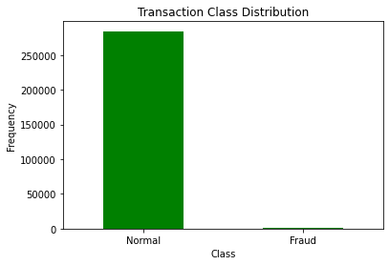
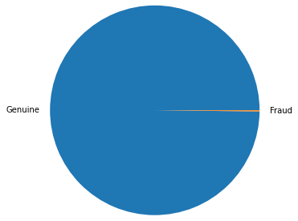
Data Visualization and Exploration
Training unbalanced data with algorithms lead to the bias in the predictions and misclassification of fraud transaction class.

Slide 8
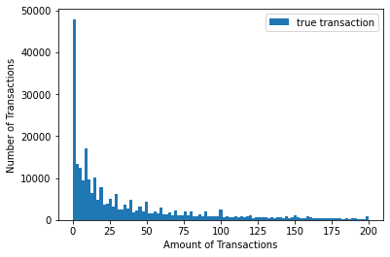
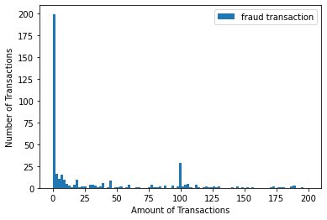
Visualization of the number of fraud and true transactions with respect to the amount involved in the transactions: 1.Maximum amount involved in the True transactions was much higher than 200 2.More than 80% of the transaction had amount less than 200

Slide 9
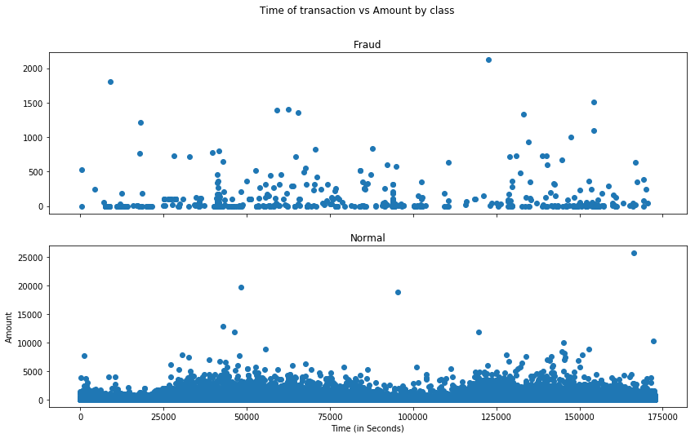
Visualization Of The Amount Of With Respect To Time
No specific pattern in the amount involved in the transaction with respect to time.
Thus, time feature is not playing an important role in predicting the if the transaction is fraud or true.

Slide 10
Feature Correlation:
A correlation matrix is a way to show the correlation between different variables in a dataset.
Positive Correlation:
As feature X increases, feature Y increases and, vice versa.
Negative Correlation:
As feature X go in one direction(Increase), feature Y goes in the other direction(Decrease).

Slide 11
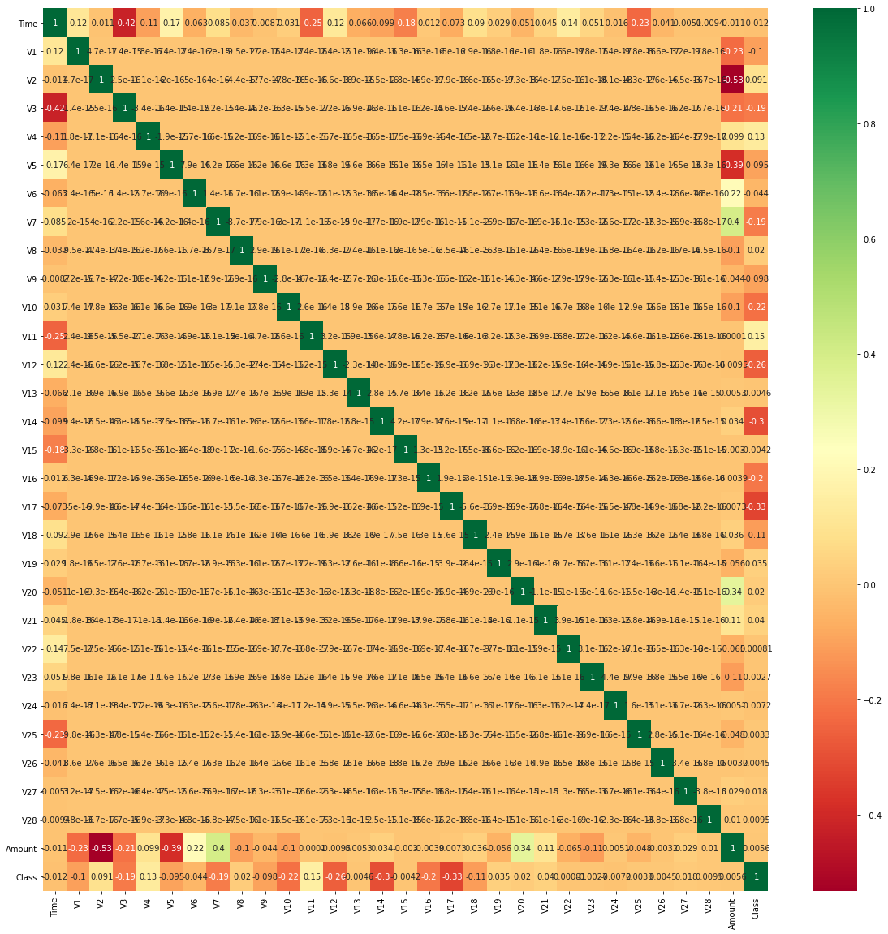
Correlation of unbalanced dataset

Slide 12
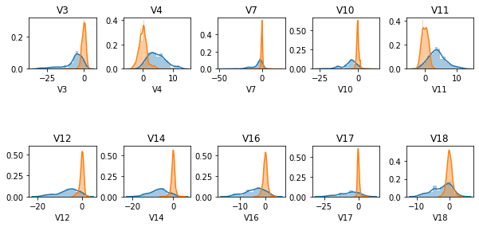
Feature Selection
Best Features

Slide 13
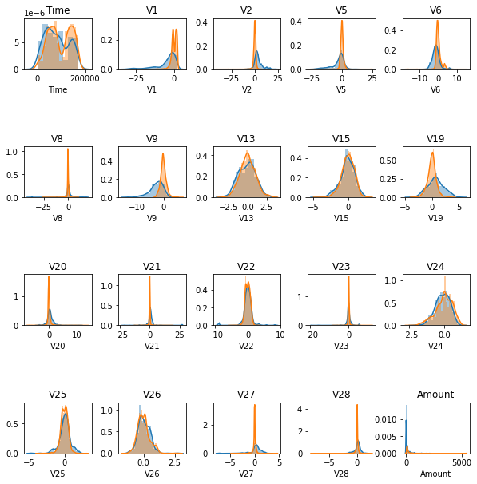
Bad Features

Slide 14
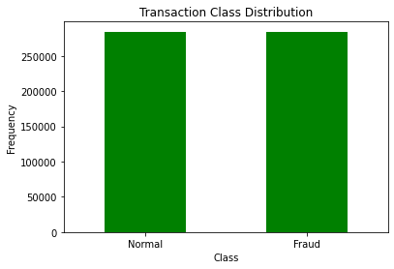
Data Preprocessing
Transaction class after using oversampling technique.

Slide 15
Parameters for building and tuning the models
The training dataset used for model building and tuning.
The testing dataset is used to evaluated the model performance.
Initially, built the Logistic Regression on training dataset as a benchmark model to evaluate the performance of other models.
Similarly, built the Logistic Regression on training dataset of sampled dataset.
Use the same method for building and tuning the other models for both balanced and unbalanced dataset.
Calculate the performance metrics for the Logistic Regression Model and based on that evaluate the performance of other models too.
Determine the performance of all other algorithms based on their Accuracy, precision, recall, confusion matrix.

Slide 16
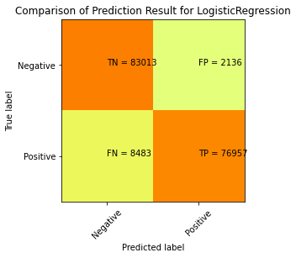
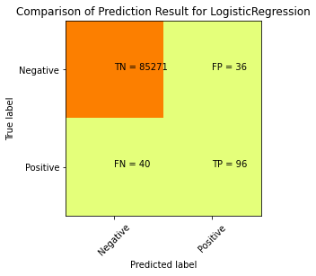
Model Evaluation and Validation
Logistic Regression for
balanced data
Logistic Regression for unbalanced data

Slide 17
Insights:
Performance of the Logistic Regression model of balanced data and its scores of Accuracy:93.8%
Performance of the Logistic Regression model of unbalanced data and its scores of Accuracy:99.9%

Slide 18
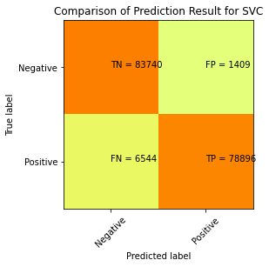
Support vector Machine
Performance of the SVC model of balanced data and its scores of Accuracy : 95.3%

Slide 19
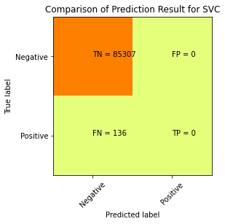
Performance of the SVC model of unbalanced data and its scores of Accuracy : 99.8%

Slide 20
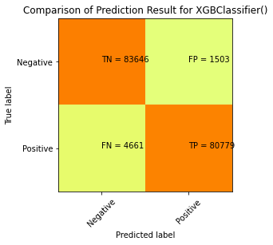
Extreme Gradient Boosting Classifier
Performance of the XGB Classifier model of balanced data and its scores of Accuracy : 96.4%

Slide 21
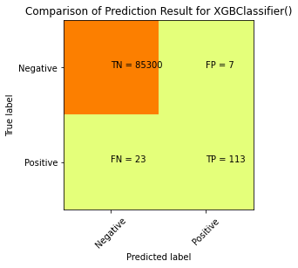
Performance of the XGB Classifier model of unbalanced data and its scores of Accuracy : 100.0%

Slide 22
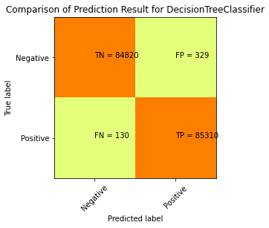
Decision Tree Classifier
Performance of the Decision Tree Classifier model of balanced data and its scores of Accuracy : 99.7%

Slide 23
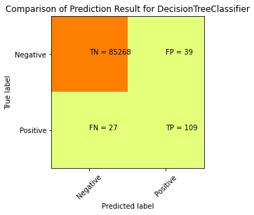
Performance of the Decision Tree Classifier model of unbalanced data and its scores of Accuracy : 99.9%

Slide 24
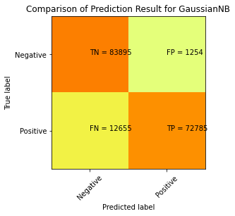
Gaussian Naïve Bayes Algorithm
Performance of the Gaussian Naïve Bayes model of balanced data and its scores of Accuracy : 91.8%

Slide 25
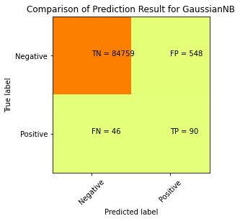
Performance of the Gaussian Naïve Bayes model of unbalanced data and its scores of Accuracy : 99.3%

Slide 26
Accuracy Conclusion
Accuracy score of all Supervised Algorithms of balanced dataset.
Logistic Regression : 93.8%
SVC : 95.3%
XGB Classifier : 96.4%
Decision Tree : 99.7%
Gaussian Naive Bayes : 91.8%
In the balanced dataset, XGB Classifier has high accuracy score which equal to 1 than all the other and Gaussian Naïve Bayes has the least accuracy score.

Slide 27
Recall Conclusion
Accuracy score of all Supervised Algorithms of balanced dataset.
Logistic Regression : 90%
SVC : 92%
XGB Classifier : 95%
Decision Tree : 99.7%
Gaussian Naive Bayes : 85%
In the balanced dataset, Decision has high recall score which equal to 1 than all the other and Gaussian Naïve Bayes has the least recall score.

Slide 28
Key Takeways:
Supervised Learning Methods and neural network technique performed well for both balanced and imbalanced datasets
In balanced dataset Decision Tree Classifier has higher accuracy followed by XGB Classifier, Logistic Regression, Gaussian Naïve Bayes, SVC.
In contrast to that, Logistic Regression has higher recall score followed by the XGB Classifier, Logistic Regression, Gaussian Naïve Bayes, SVC.
Reflections :
Feature Engineering
Feature Scaling
Balanced data
Unbalanced data

